Slide 1

Introduction to Deep Learning
TA: Drew Hudson
May 8, 2020
Slides credits: Atharva Parulekar, Jingbo Yang, Drew Hudson, Guanzhi Wang

Slide 2
Overview
Motivation for deep learning
Convolutional neural networks
Recurrent neural networks
Deep learning tools

Slide 3
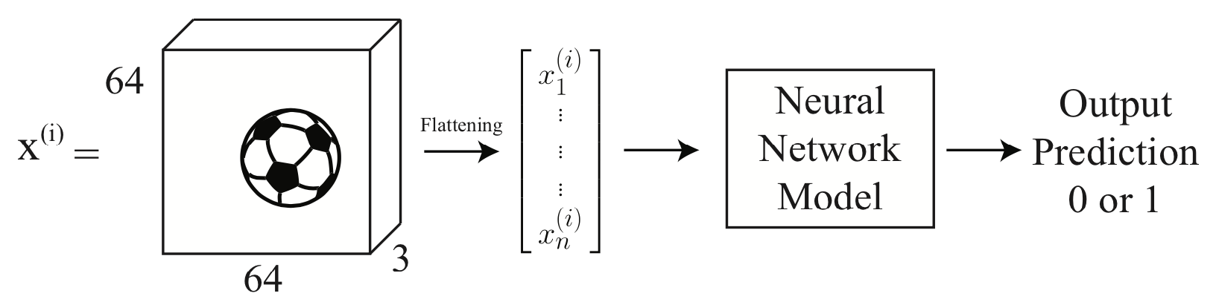

But we learned multi-layer perceptron in class?
Expensive to learn. Will not generalize well
Does not exploit the order and local relations in the data!
64x64x3=12288 parameters
We also want many layers

Slide 4
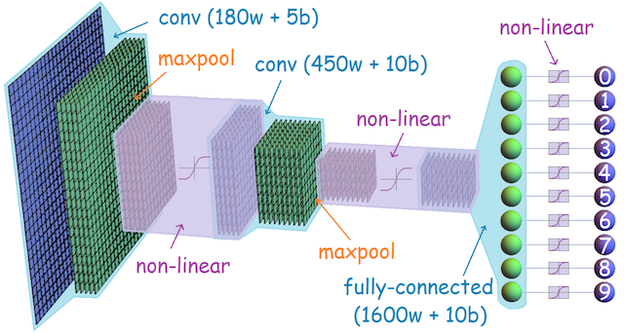
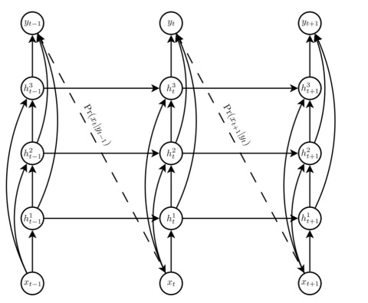
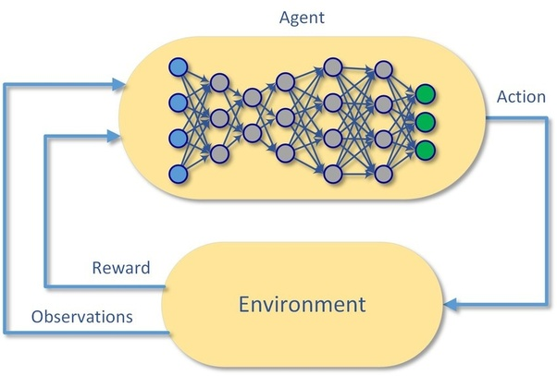
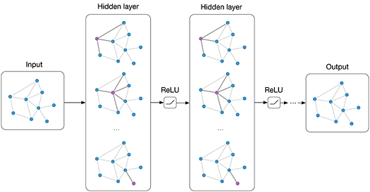
What are areas of deep learning?
Convolutional NN
Image
Recurrent NN
Time Series
Graph NN
Networks/Relational
Deep RL
Control System

Slide 5
What are areas of deep learning?
Convolutional
Neural Network
Recurrent NN
Deep RL
Graph NN

Slide 6
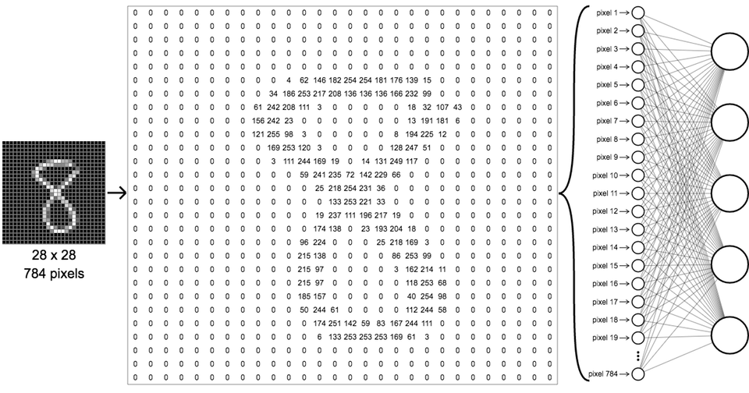
Let us look at images in detail

Slide 7


Filters
Why not extract features using filters?
Better, why not let the data dictate what filters to use?
Learnable filters!!

Slide 8
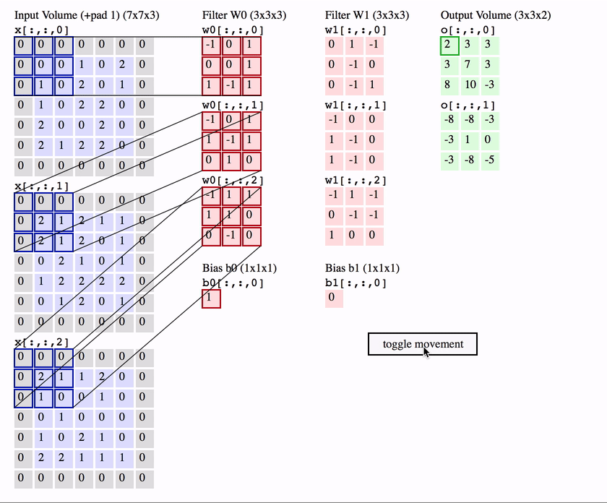
Convolution on multiple channels
Images are generally RGB !!
How would a filter work on a image with RGB channels?
The filter should also have 3 channels.
Now the output has a channel for every filter we have used.

Slide 9
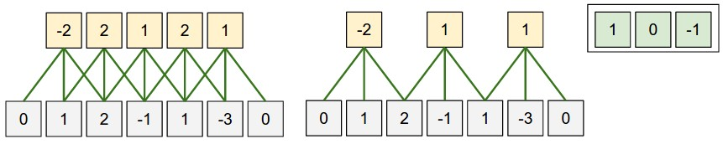
Parameter sharing
Lesser the parameters less computationally intensive the training. This is a win win as we are reusing parameters.

Slide 10
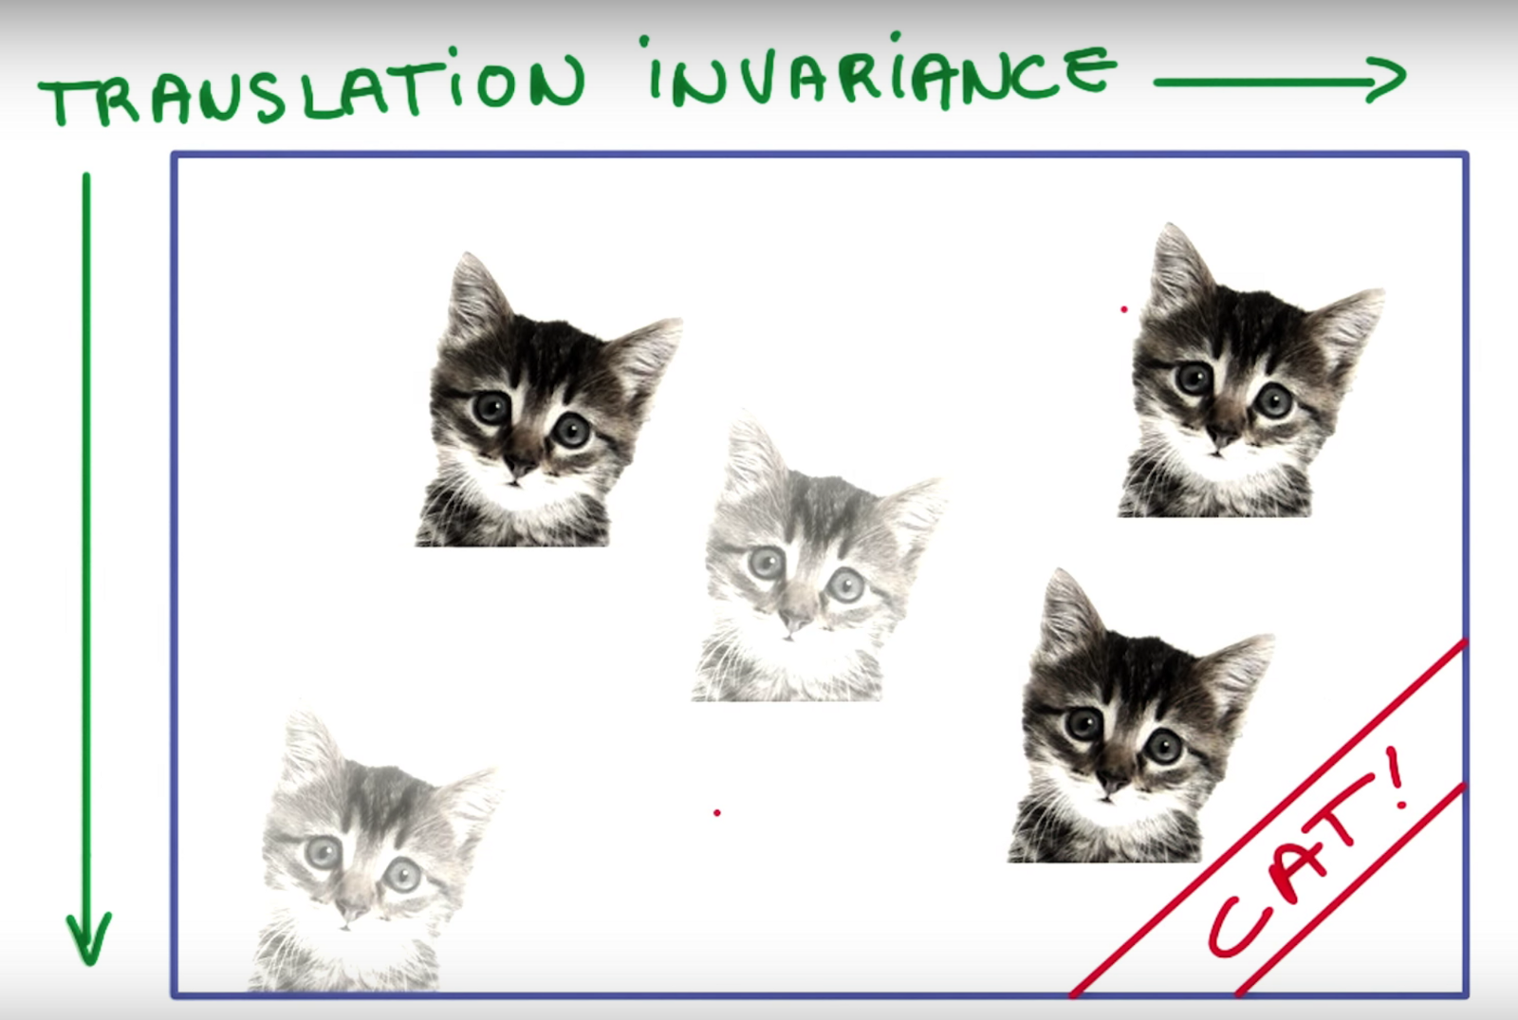
Translational invariance
Since we are training filters to detect cats and the moving these filters over the data, a differently positioned cat will also get detected by the same set of filters.

Slide 11
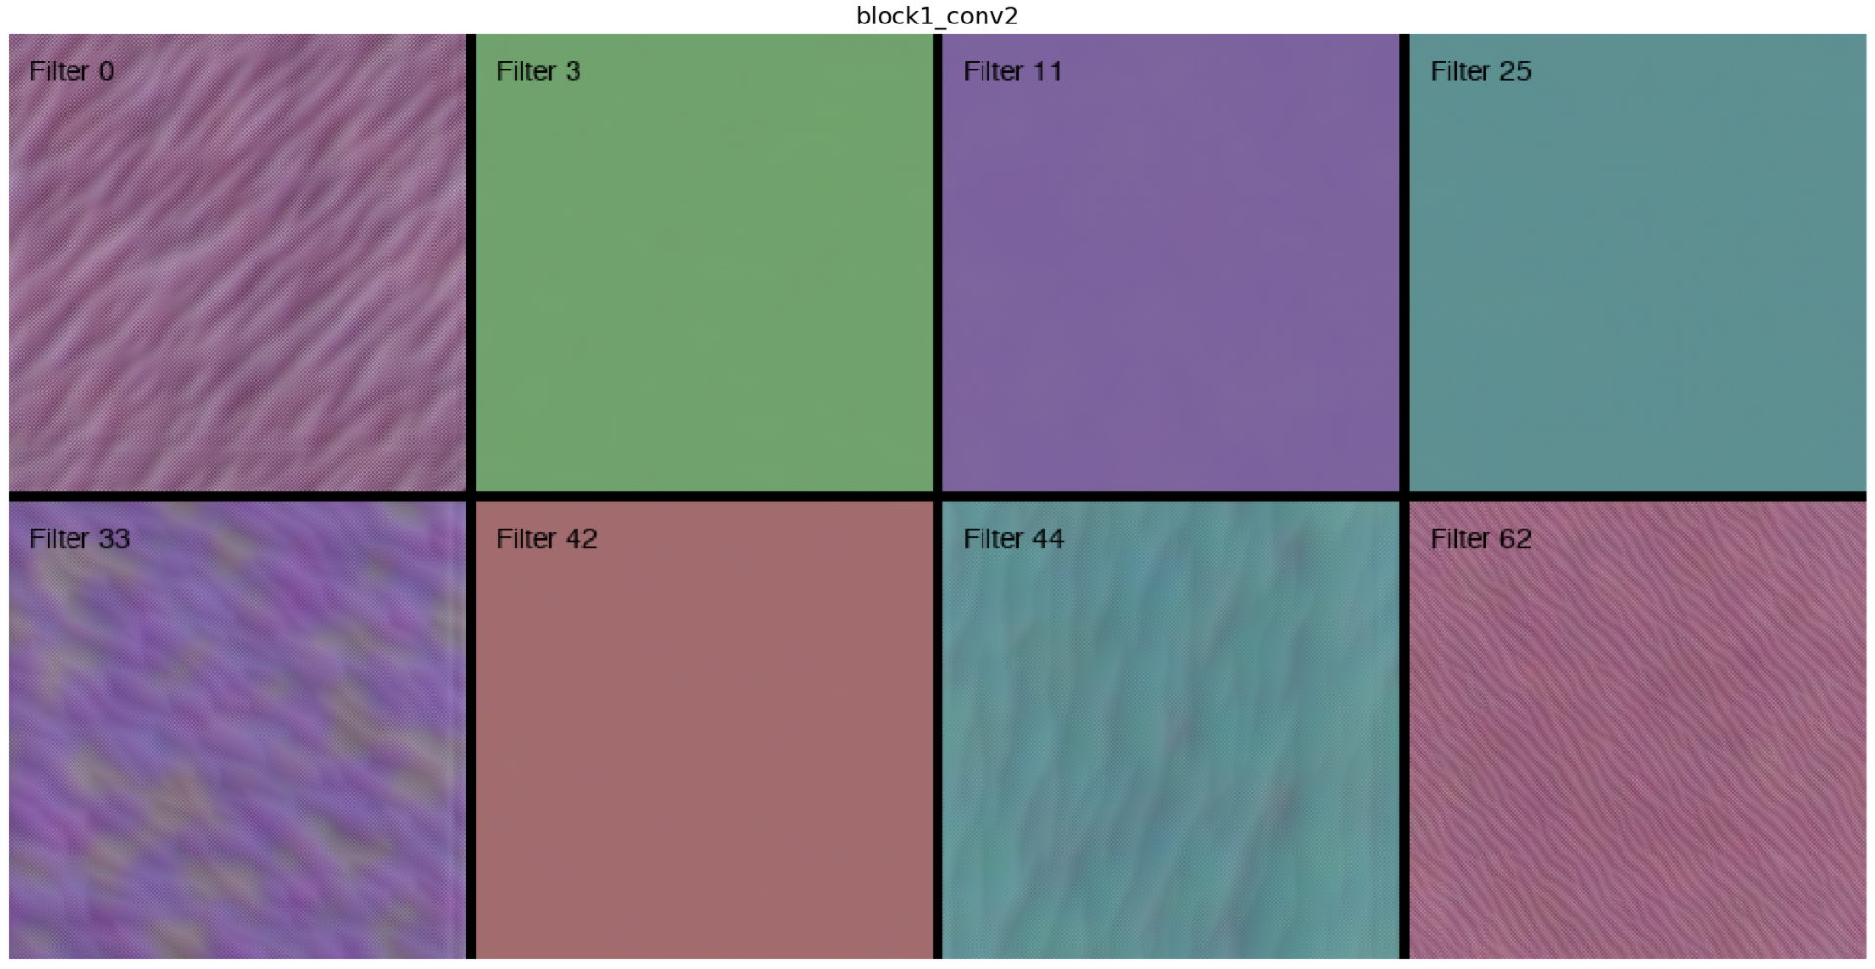
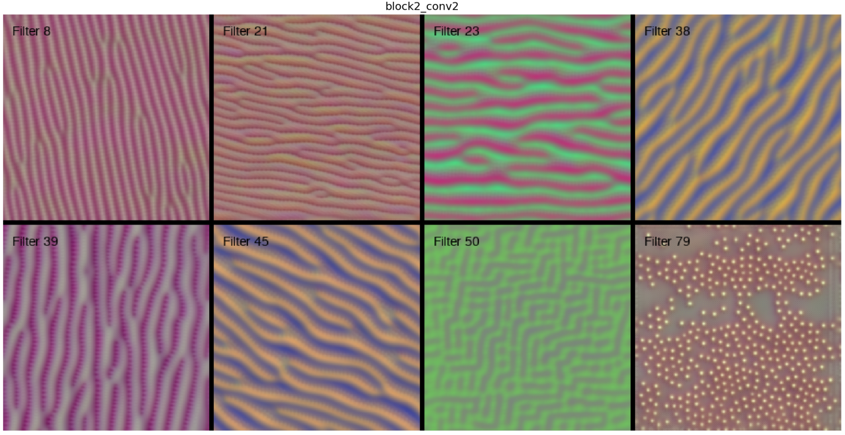
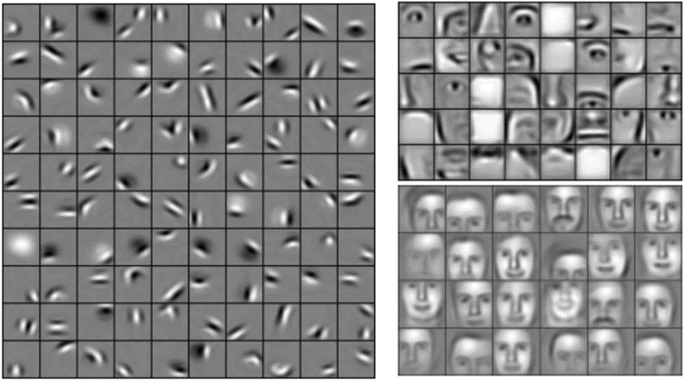
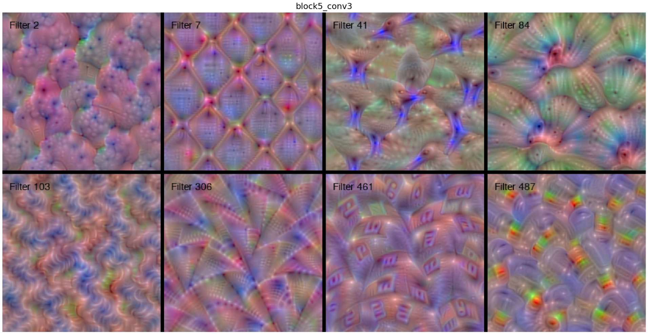
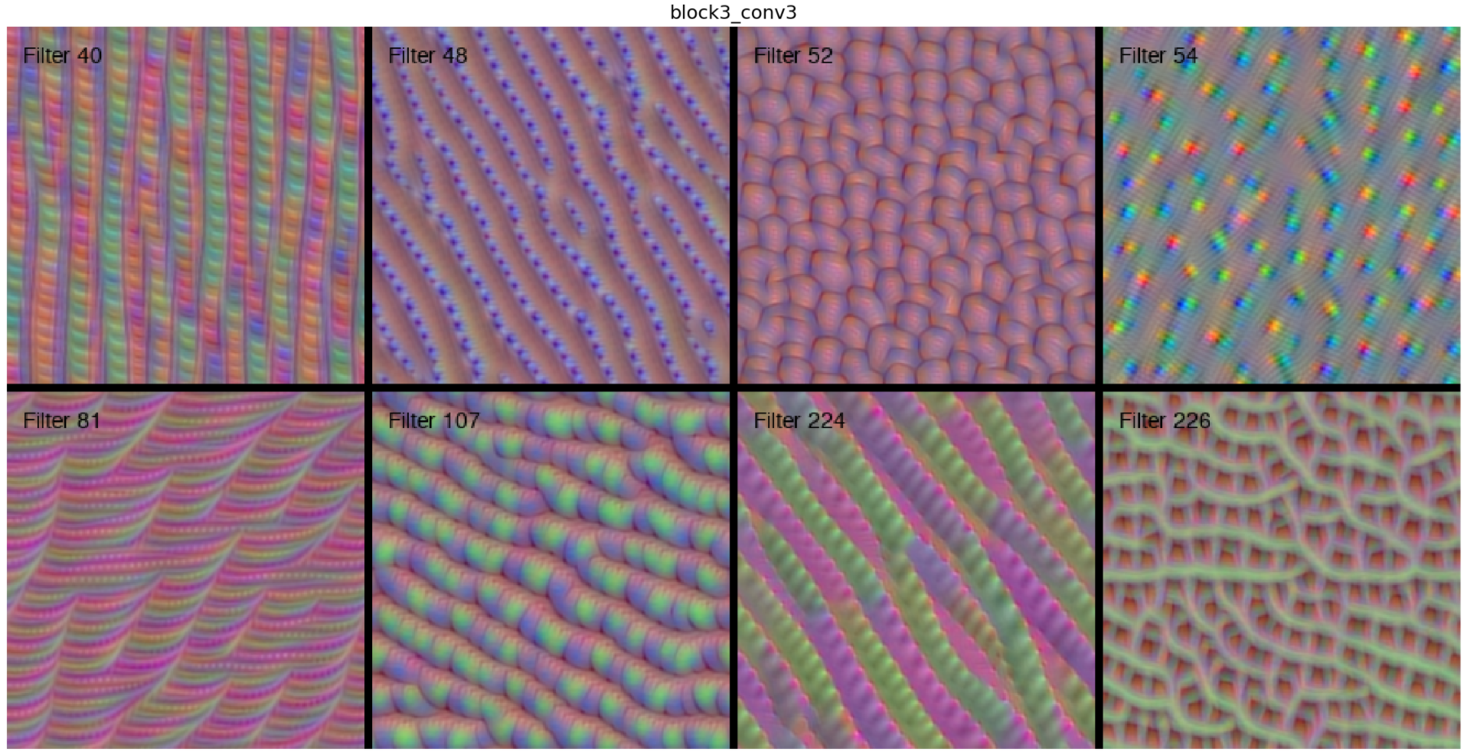
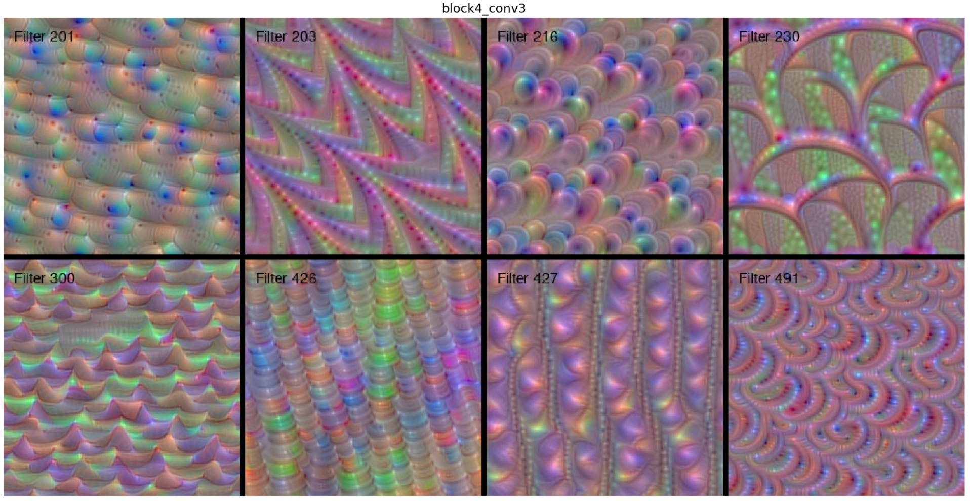
Filters? Layers of filters?
Images that maximize filter outputs at certain layers. We observe that the images get more complex as filters are situated deeper
How deeper layers can learn deeper embeddings. How an eye is made up of multiple curves and a face is made up of two eyes.

Slide 12
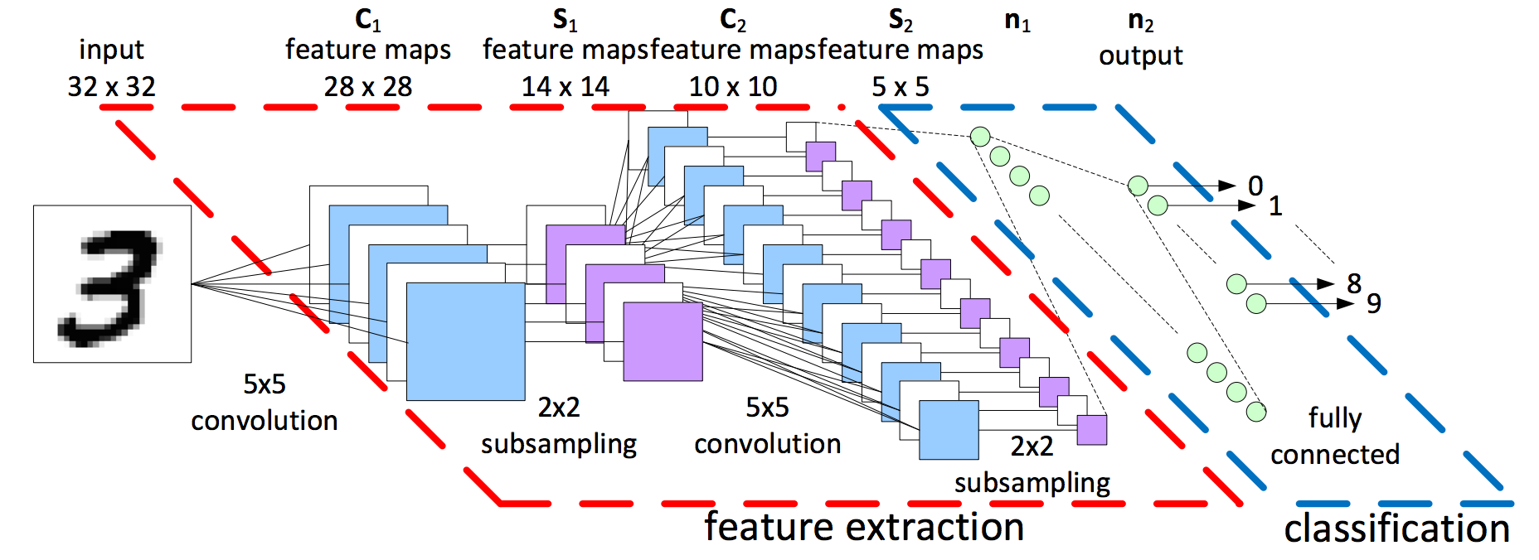
How do we use convolutions?
Let convolutions extract features and let normal cnn’s decide on them.
Image credit: LeCun et al. (1998)

Slide 13
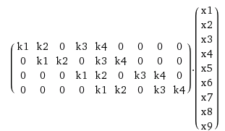
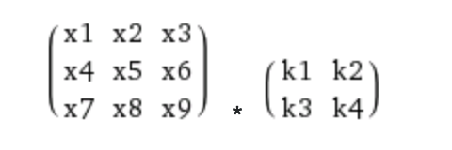
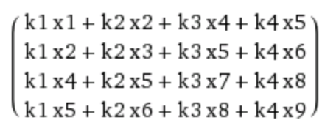
Convolution really is just a linear operation
In fact convolution is a giant matrix multiplication.
We can expand the 2 dimensional image into a vector and the conv operation into a matrix.

Slide 14
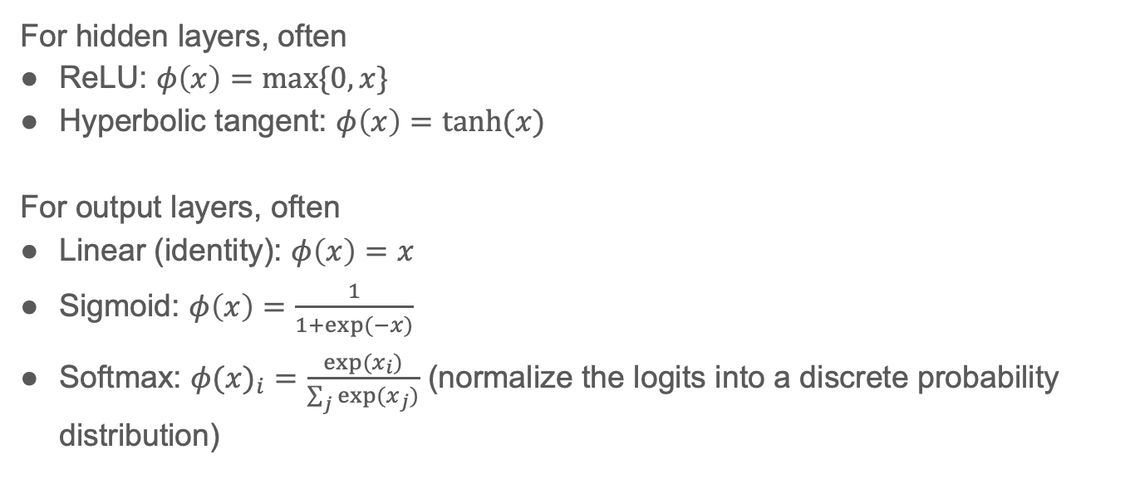
Nonlinearities/Activations
For hidden layers, often
ReLU: $φ\left(x\right)=\max{\{0,x\}}$
Hyperbolic tangent: $φ\left(x\right)=\tanh{(x)}$
For output layers, often
Linear (identity): $φ\left(x\right)=x$
Sigmoid: $φ\left(x\right)=\frac{1}{1+\exp{(−x)}}$
Softmax: ${φ(x)}_{i}=\frac{\exp{(x_{i})}}{\sum_{j}{exp⁡(x_{j})}}$ (normalize the logits into a discrete probability distribution)

Slide 15

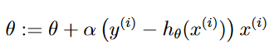

How do we learn?
Instead of
They are “optimizers”
Momentum: Gradient + Momentum
Nestrov: Momentum + Gradients
Adagrad: Normalize with sum of sq
RMSprop: Normalize with moving avg of sum of squares
ADAM: RMsprop + momentum
https://ruder.io/optimizing-gradient-descent/

Slide 16
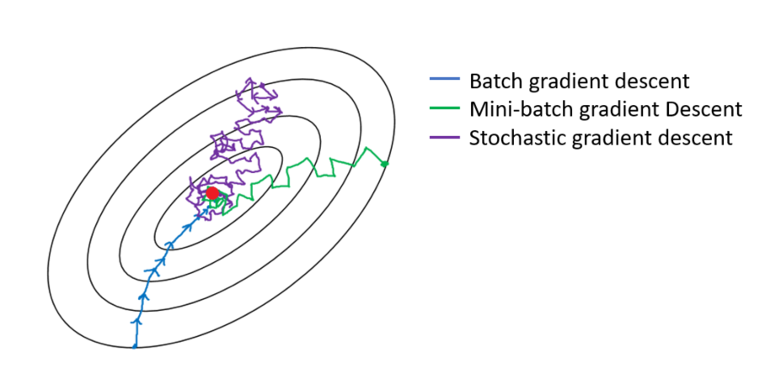
Mini-batch Gradient Descent
Expensive to compute gradient for large dataset
Memory size
Compute time
Mini-batch: takes a sample of training data
How to we sample intelligently?

Slide 17

Is deeper better?
Deeper networks seem to be more powerful but harder to train.
Loss of information during forward propagation
Loss of gradient info during back propagation
There are many ways to “keep the gradient going”

Slide 18
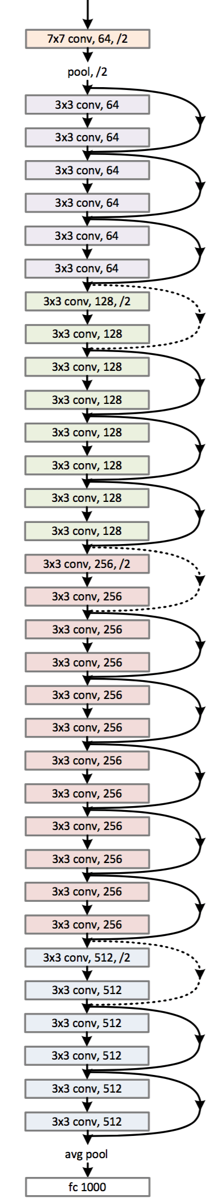
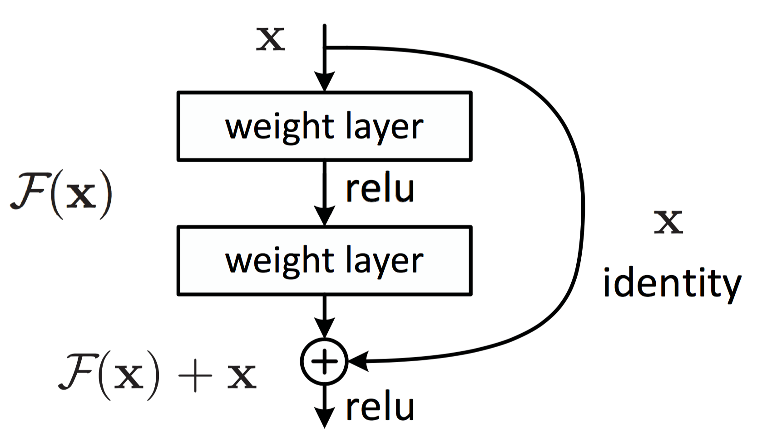
Solution
Connect the layers, create a gradient highway or information
highway.
ResNet (2015)
Image credit: He et al. (2015)

Slide 19
Initialization
Can we initialize all neurons to zero?
If all the weights are same we will not be able to break symmetry of the network and all filters will end up learning the same thing.
Large numbers, might knock relu units out.
Relu units once knocked out and their output is zero, their gradient flow also becomes zero.
We need small random numbers at initialization.
Variance : 1/sqrt(n)
Mean: 0
Popular initialization setups
(Xavier, Kaiming) (Uniform, Normal)

Slide 20

Dropout
What does cutting off some network connections do?
Trains multiple smaller networks in an ensemble.
Can drop entire layer too!
Acts like a really good regularizer

Slide 21
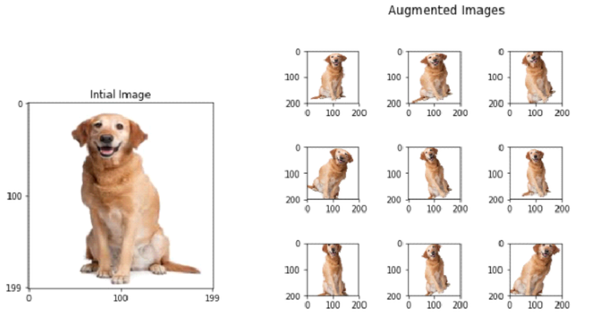
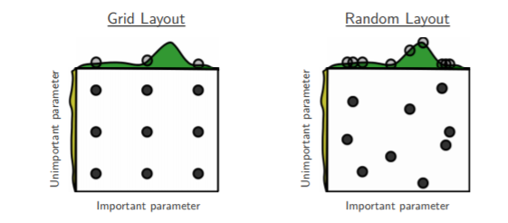
Tricks for training
Data augmentation if your data set is smaller. This helps the network generalize more.
Early stopping if training loss goes above validation loss.
Random hyperparameter search or grid search?

Slide 22
CNN sounds like fun!
What are some other areas of deep learning?
Recurrent NN
Time Series
Convolutional NN
Deep RL
Graph NN

Slide 23
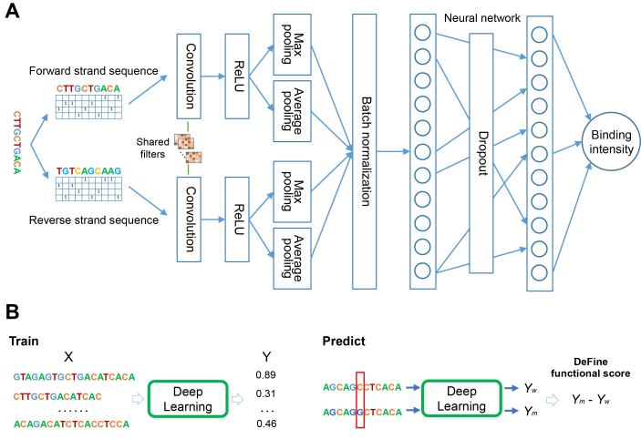
We can also have 1D architectures (remember this)
CNN works on any data where there is a local pattern
We use 1D convolutions on DNA sequences, text sequences and music notes
But what if time series has causal dependency or any kind of sequential dependency?

Slide 24
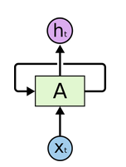
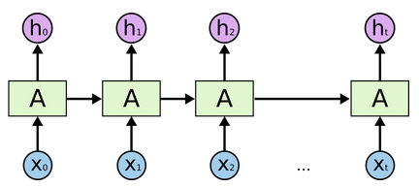
To address sequential dependency?
Use recurrent neural network (RNN)
Latent Output
Unrolling an RNN
Previous output
One time step
RNN Cell
They are really the same cell,
NOT many different cells like kernels of CNN

Slide 25
How does RNN produce result?
Evolving “embedding”
Result after reading full sentence
I love CS !

Slide 26
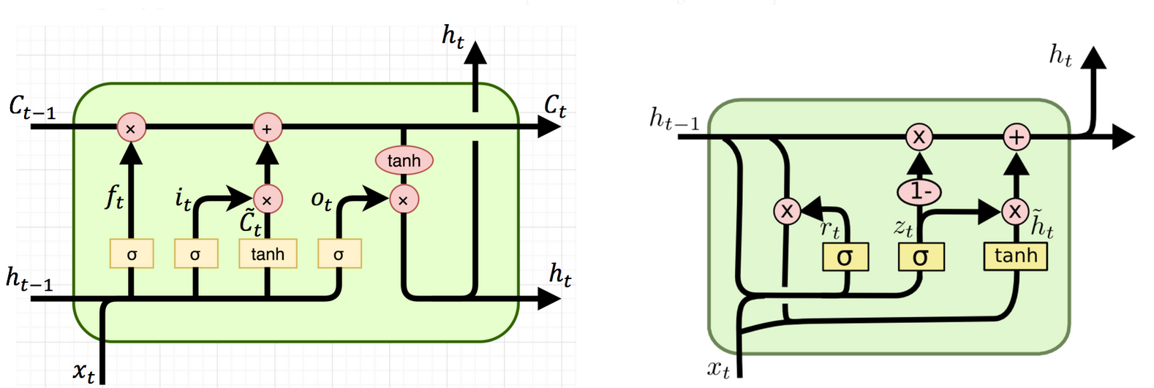
There are 2 types of RNN cells
Store in “long term memory”
Response to current input
Reset gate
Update gate
Response to current input
Long Short Term Memory (LSTM)
Gated Recurrent Unit (GRU)

Slide 27
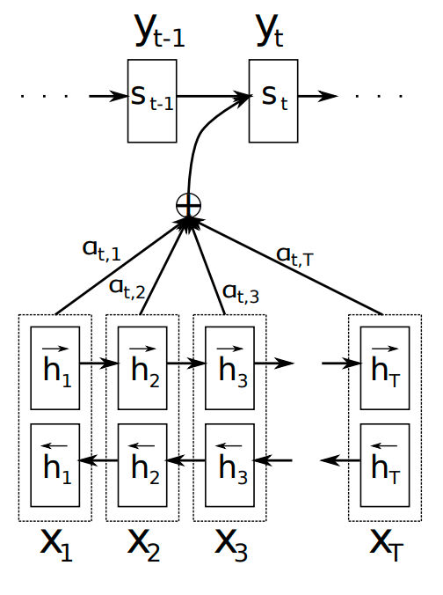
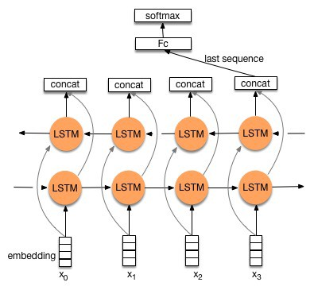
Recurrent AND deep?
Taking last value
Pay “attention” to everything
Stacking
Attention Model

Slide 28
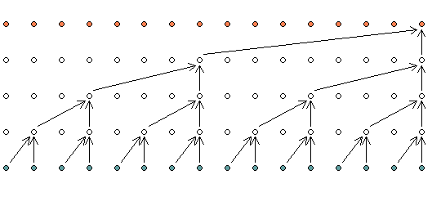
“Recurrent” AND convolutional?
Temporal convolutional network
Temporal dependency achieved through “one-sided” convolution
More efficient because deep learning packages are optimized for matrix multiplication = convolution
No hard dependency

Slide 29
More? Take CS230, CS236, CS231N, CS224N
Convolutional NN
Image
Recurrent NN
Time Series
Graph NN
Networks/Relational
Deep RL
Control System

Slide 30
Not today, but take CS234 and CS224W
Convolutional NN
Image
Recurrent NN
Time Series
Graph NN
Networks/Relational
Deep RL
Control System

Slide 31







Tools for deep learning
Specialized Groups
Popular Tools

Slide 32
$50 not enough! Where can I get free stuff?
Google Colab
Free (limited-ish) GPU access
Works nicely with Tensorflow
Links to Google Drive
Register a new Google Cloud account
=> Instant $300??
=> AWS free tier (limited compute)
=> Azure education account, $200?
Azure Notebook
Kaggle kernel???
Amazon SageMaker?
To SAVE money
CLOSE your GPU instance
~$1 an hour
Notes:
https://colab.research.google.com/drive/1Enc-pKlP4Q3cimEBfcQv0B_6hUvjVL3o

Slide 33
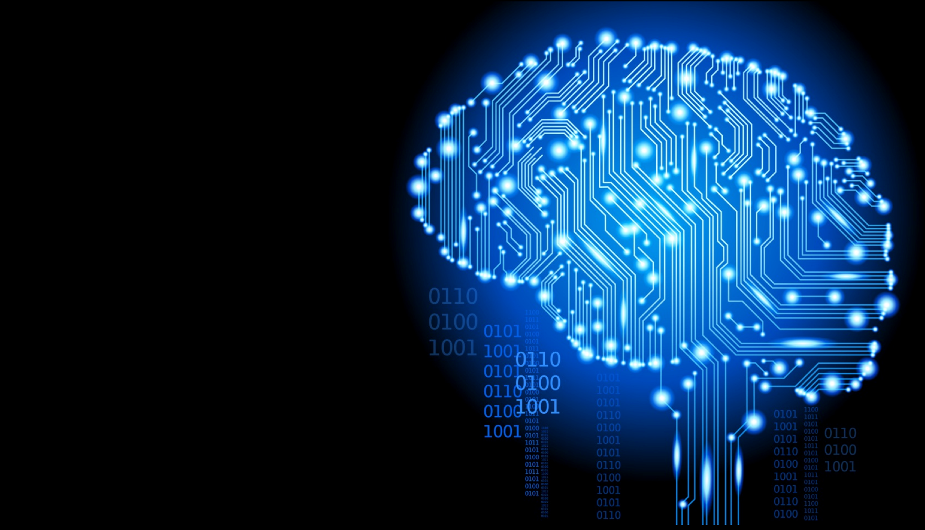
Good luck!
Well, have fun too :D

